Slide 1



Portfolio project- Data Professional Survey Data
View in Power BI
Last data refresh:
3/15/2023 12:47:38 AM UTC
Downloaded at:
3/18/2023 7:58:55 PM UTC

Slide 2
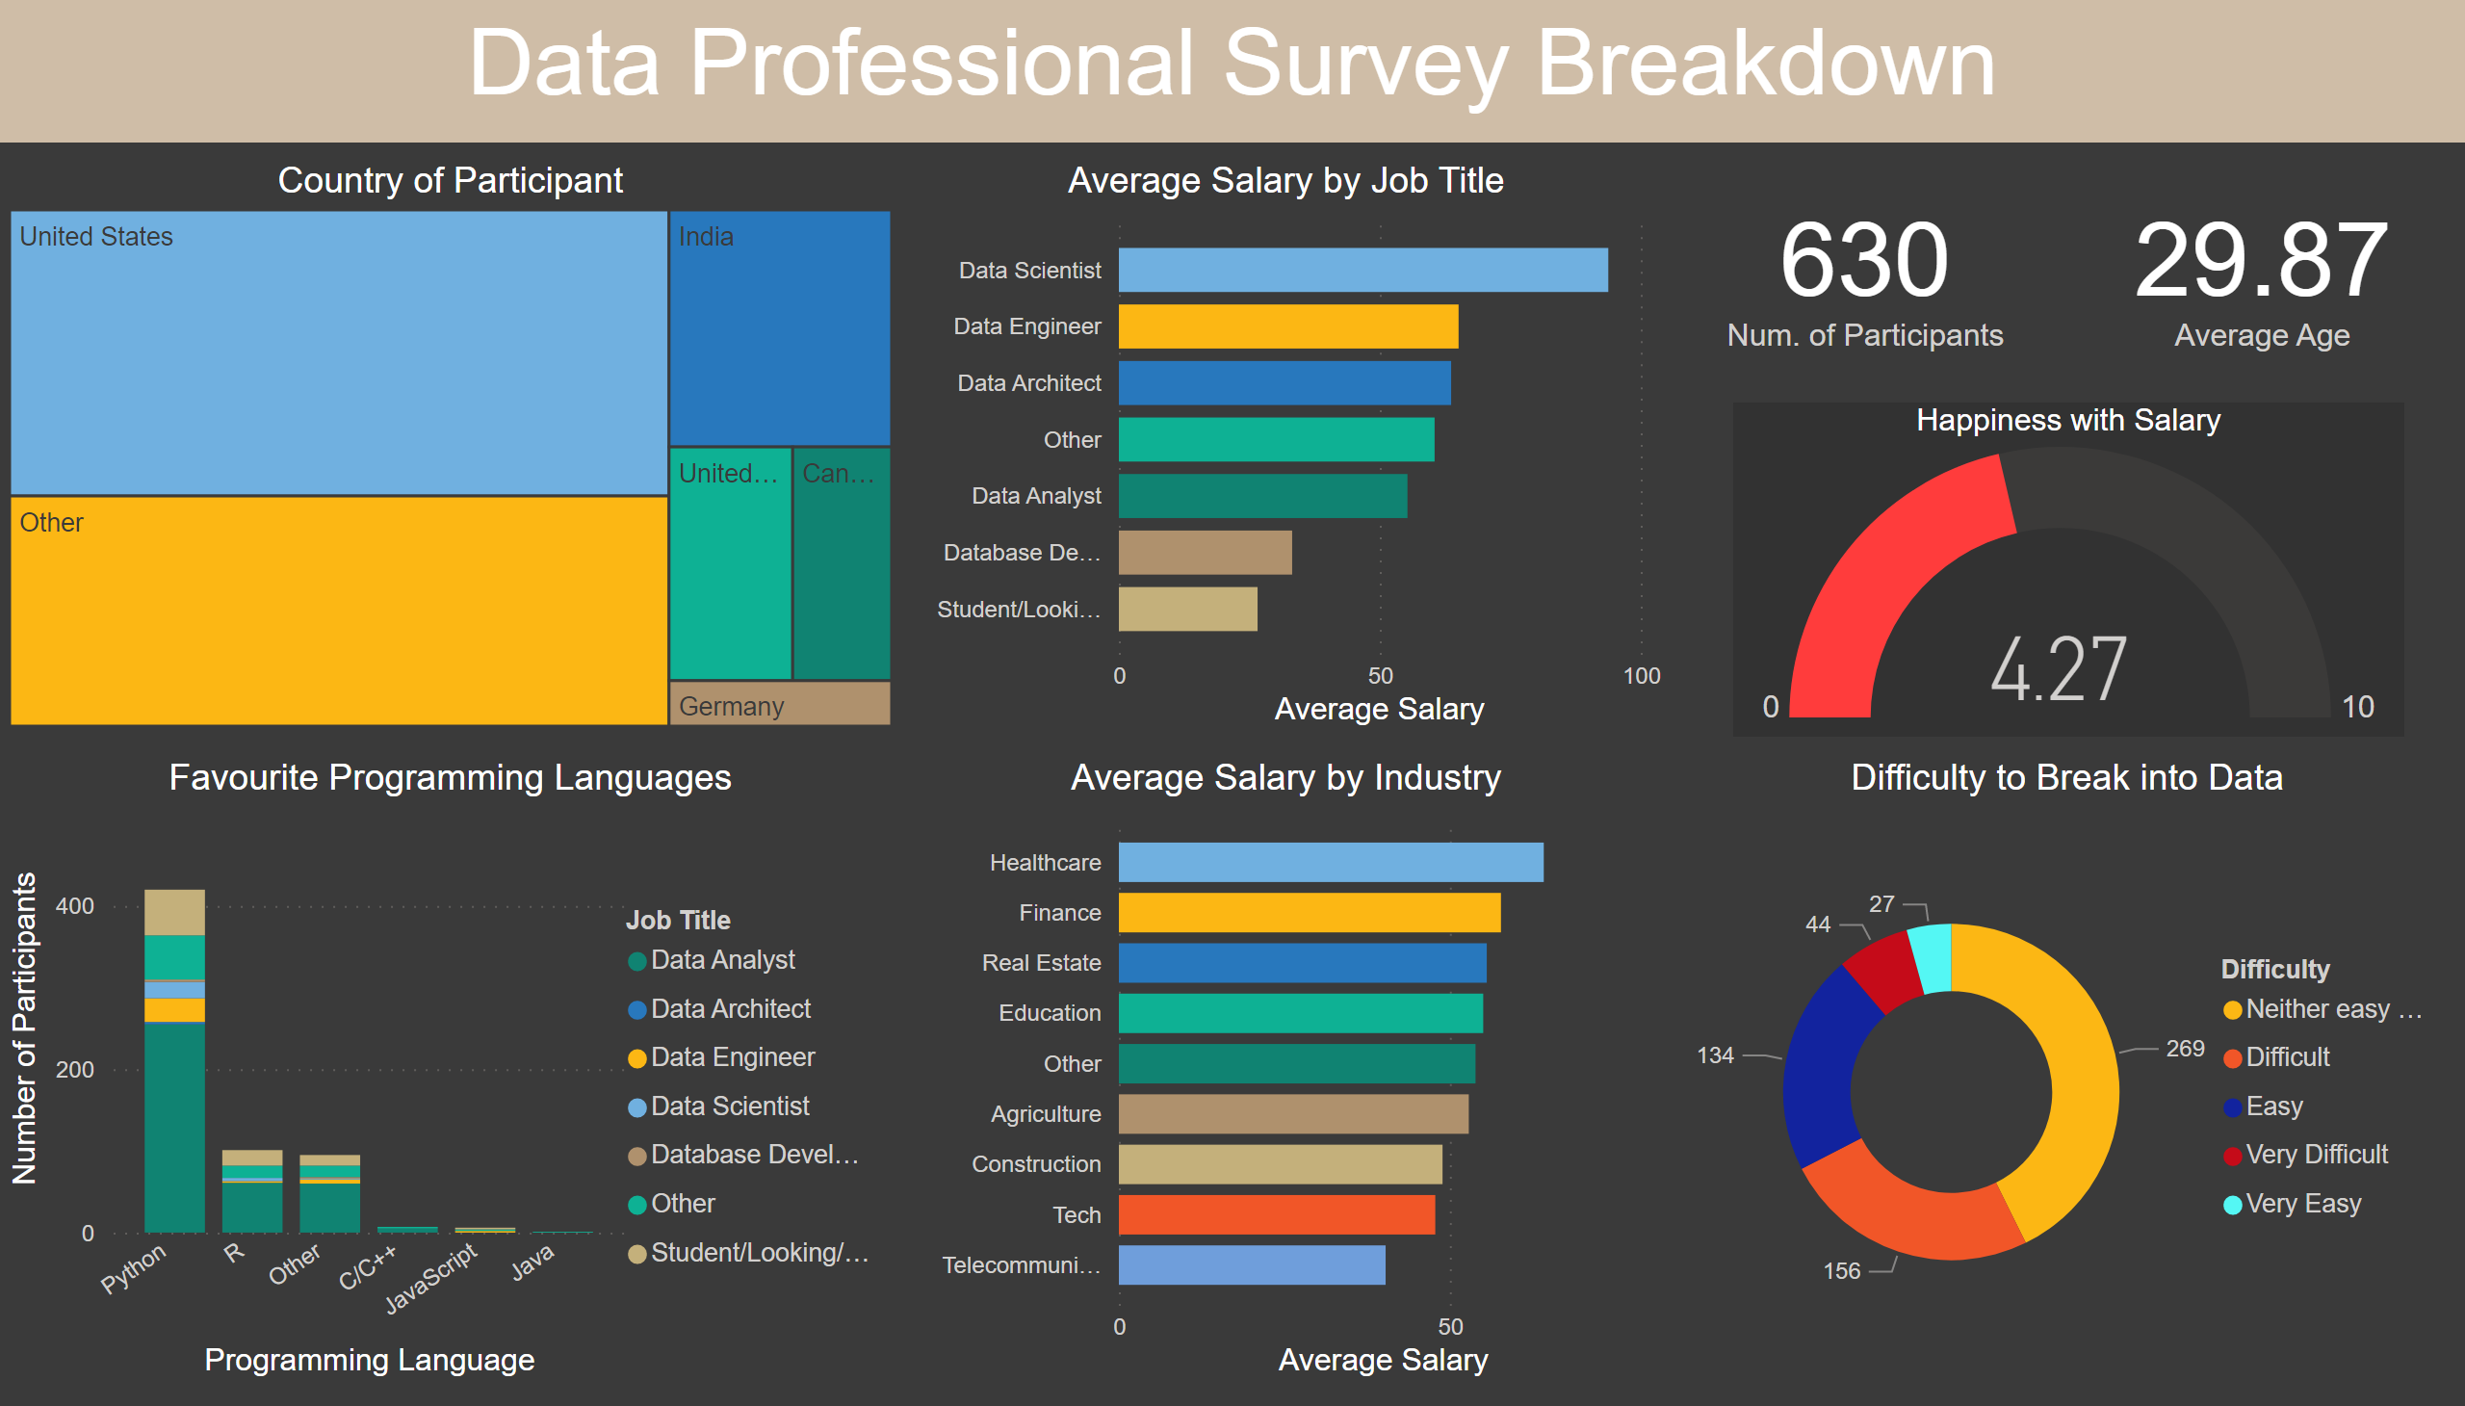
Data Professional Survey Analysis
Notes:
textbox
No alt text provided
card
No alt text provided
card
No alt text provided
Average Salary by Job Title
No alt text provided
Favourite Programming Languages
No alt text provided
Country of Participant
No alt text provided
Happiness with Salary
No alt text provided
Difficulty to Break into Data
No alt text provided
Average Salary by Industry
No alt text provided

